Slide 1
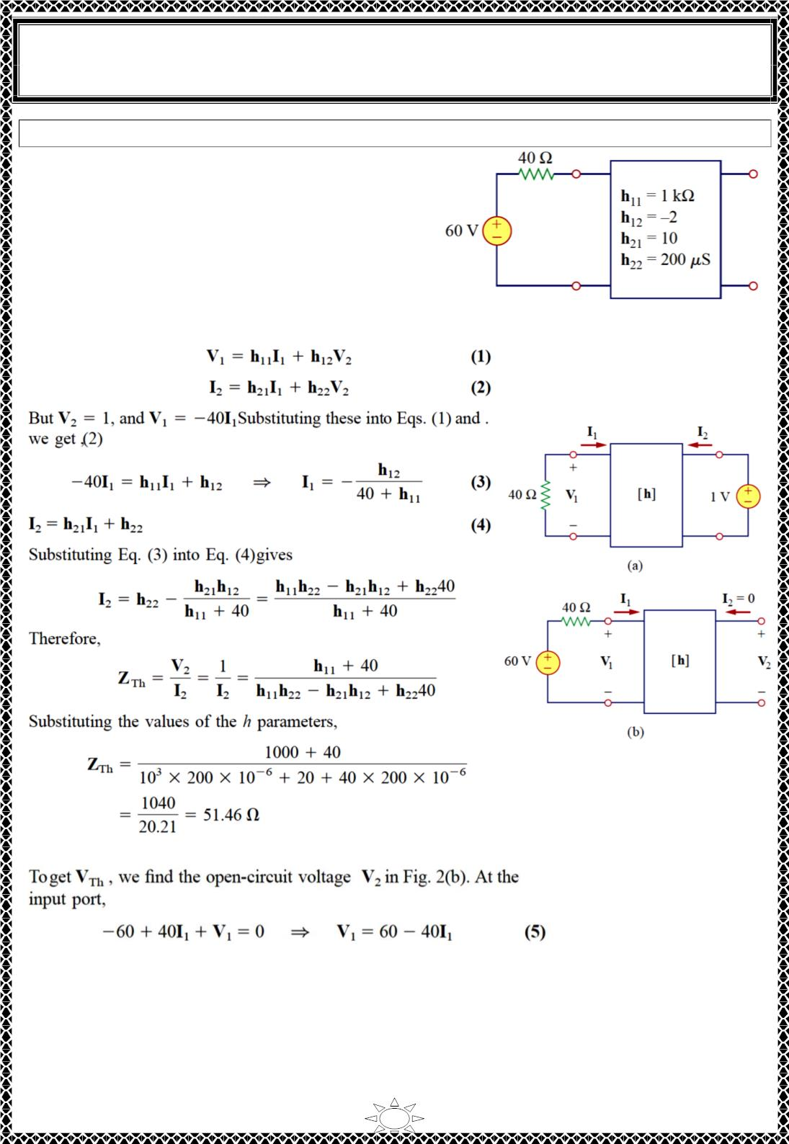
University of Diyala
Engineering College
Electronic Department
Electrical Circuits
2nd Class
Lecturer : Wisam N. AL-Obaidi
Year (2015-2016)
Example 6: Determine the Thevenin equivalent at the output port of the circuit inFig.
Solution:
To find ZTh and VTh, we apply the normal
procedure, keeping in mind the formulas relating
the input and output ports of the h model. To
obtain ZTh , remove the 60-V voltage source at
the input port and apply a 1-V voltage source at
the output port, as shown in Fig. 2(a). From Eq.
(4.1),
Fig. 1
Trail Version
Trail Version
Trail Version
Trail Version
Trail Version
Trail Version
Trail Version
Trail Version
Trail Version
Trail Version
Trail Version
Trail Version
Trail Version
Fig. 2 (a) finding ZTh,
(b) finding VTh,
14

Slide 2
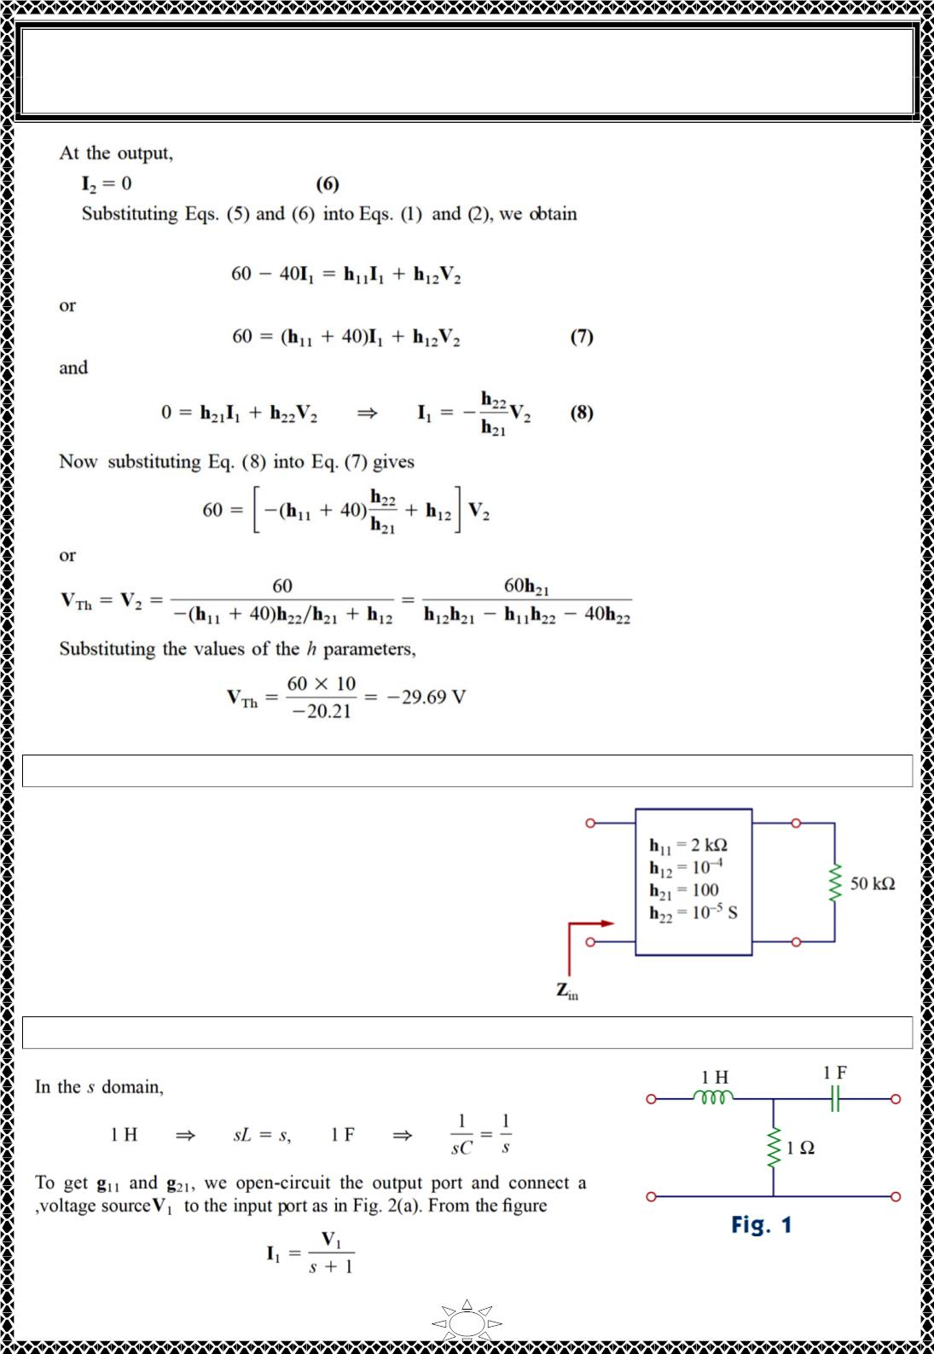
University of Diyala
Engineering College
Electronic Department
Electrical Circuits
2nd Class
Lecturer : Wisam N. AL-Obaidi
Year (2015-2016)
Trail Version
Trail Version
Trail Version
Trail Version
Trail Version
Trail Version
Trail Version
Trail Version
Trail Version
Trail Version
Trail Version
Trail Version
Trail Version
H.W.6: Find the impedance at the input port of the circuit in Fig.
Answer:
1.6667 kΩ.
Example 7: Find the g parameters as functions of s for the circuit in Fig.
Solution:
15

Slide 3
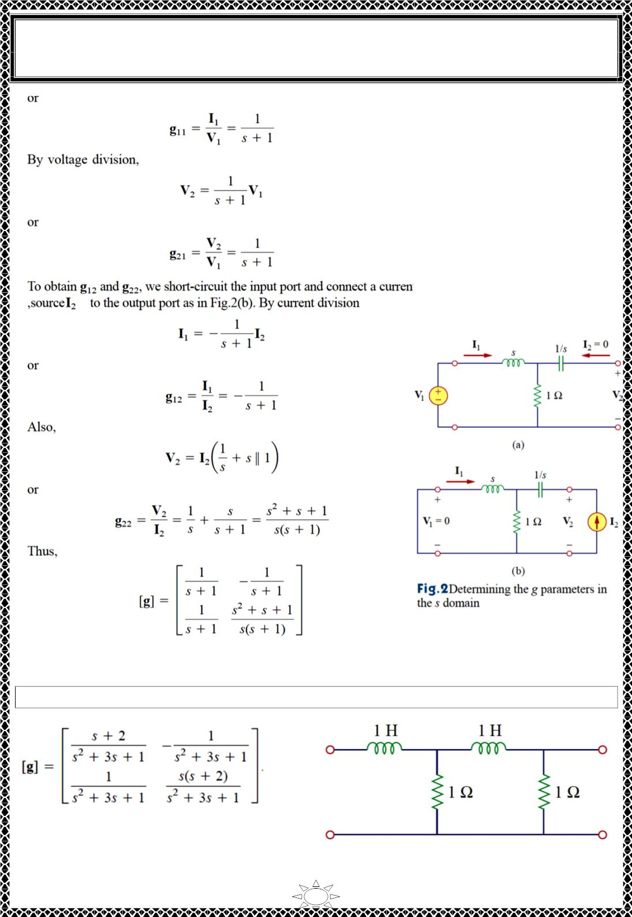
University of Diyala
Engineering College
Electronic Department
Electrical Circuits
2nd Class
Lecturer : Wisam N. AL-Obaidi
Year (2015-2016)
Trail Version
Trail Version
Trail Version
Trail Version
Trail Version
Trail Version
Trail Version
Trail Version
Trail Version
Trail Version
Trail Version
Trail Version
Trail Version
H.W.7: For the ladder network in Fig., determine the g parameters in the s domain.
Answer:
16

Slide 4
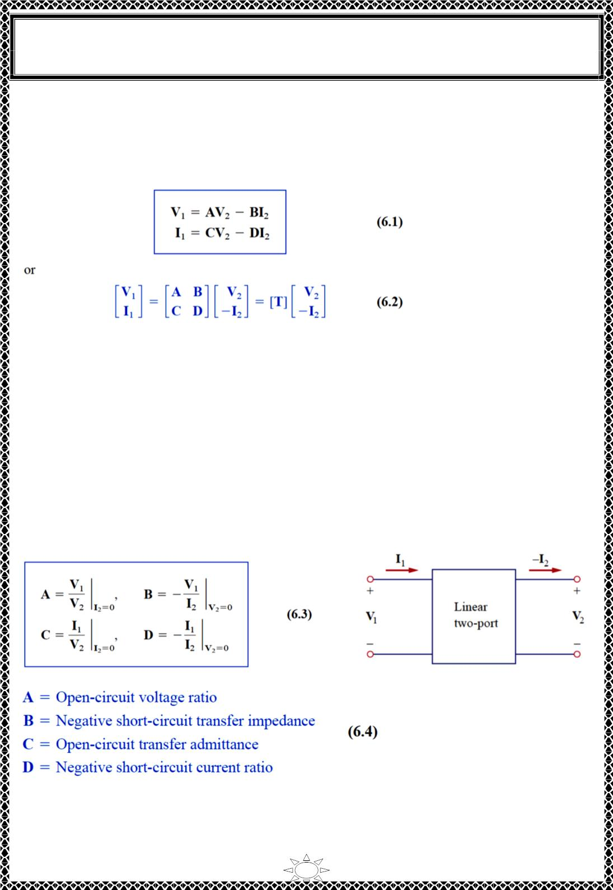
University of Diyala
Engineering College
Electronic Department
Electrical Circuits
2nd Class
Lecturer : Wisam N. AL-Obaidi
Year (2015-2016)
5)Transmission Parameters (ABCD parameters)
Since there are no restrictions on which terminal voltages and currents should be
considered independent and which should be dependent variables, we expect to be able to
generate many sets of parameters. Another set of parameters relates the variables at the
input port to those at the output port. Thus,
Equations (6.1) and (6.2) relate the input variables ( V and I ) to the output variables (V
2
1
1
and −I ). Notice that in computing the transmission parameters −I , is used rather than
2
2
I2, because the current is considered to be leaving the network, as shown in Fig. 6.1, as
opposed to entering the network as in Fig. 1.1(b). This is done merely for conventional
reasons; when you cascade two-ports (output to input), it is most logical to think of I2 as
leaving the two-port. It is also customary in the power industry to consider I2 as leaving
the two-port.
Trail Version
Trail Version
Trail Version
Trail Version
Trail Version
Trail Version
Trail Version
Trail Version
Trail Version
Trail Version
Trail Version
Trail Version
Trail Version
The transmission parameters are useful in the analysis of transmission lines (such as cable
and fiber) because they express sending-end variables (V and I ) in terms of the
1
1
receiving-end variables (V and −I ). For this reason, they are called transmission
2
2
parameters. They are also known as ABCD parameters. They are used in the design of
telephone systems, microwave networks, and radars.
The transmission parameters are determined as
Thus, the transmission parameters are called, specifically,
Fig. 6.1
A and D are dimensionless, B is in ohms, and C is in siemens. Since the transmission
parameters provide a direct relationship between input and output variables, they are very
useful in cascaded networks.
17

Slide 5
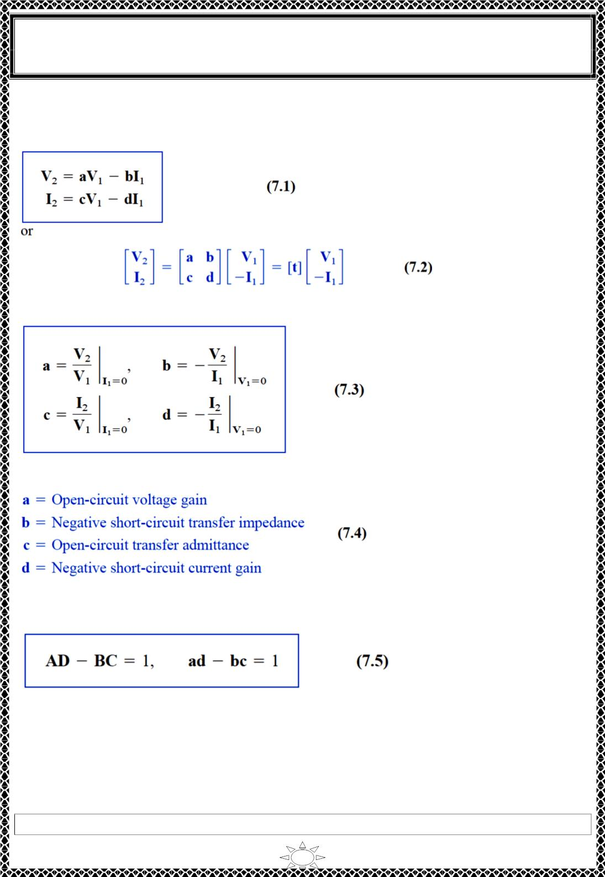
University of Diyala
Engineering College
Electronic Department
Electrical Circuits
2nd Class
Lecturer : Wisam N. AL-Obaidi
Year (2015-2016)
6)Inverse Transmission Parameters (t parameters)
Our last set of parameters may be defined by expressing the variables at the output port in
terms of the variables at the input port. We obtain
The parameters a, b, c, and d are called the inverse transmission, or t, parameters. They are
determined as follows:
Trail Version
Trail Version
Trail Version
Trail Version
Trail Version
Trail Version
Trail Version
Trail Version
Trail Version
Trail Version
Trail Version
Trail Version
Trail Version
The inverse transmission parameters are known individually as
While a and d are dimensionless, b and c are in ohms and siemens, respectively.
In terms of the transmission or inverse transmission parameters, a network is reciprocal if
These relations can be proved in the same way as the transfer impedance relations for the z
parameters.
Example 8: Find the transmission parameters for the two-port network in Fig.
18

Slide 6
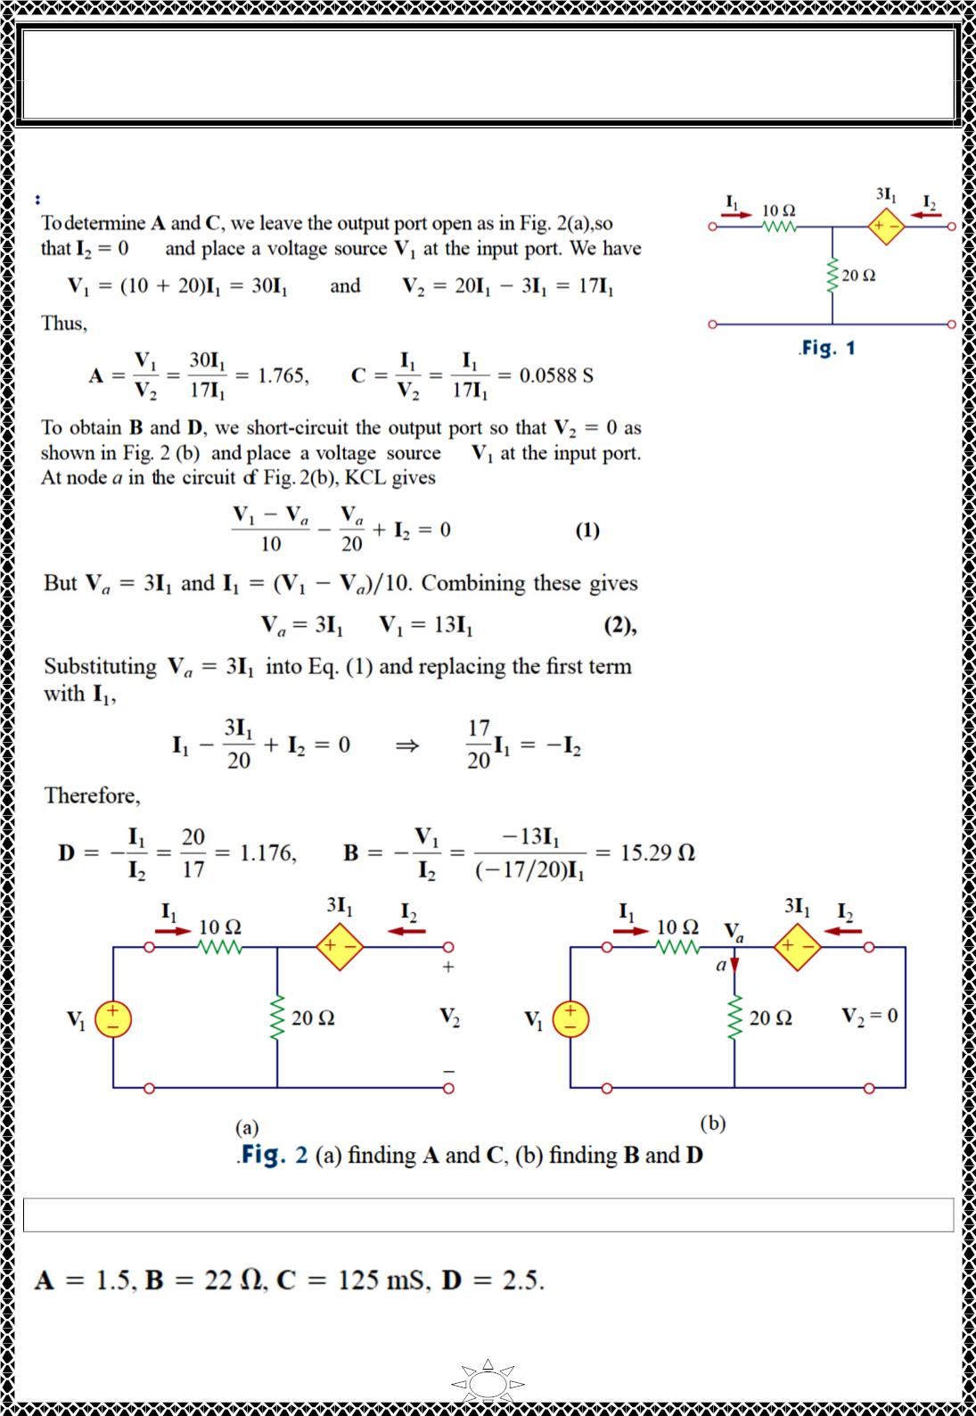
University of Diyala
Engineering College
Electronic Department
Electrical Circuits
2nd Class
Lecturer : Wisam N. AL-Obaidi
Year (2015-2016)
Solution:
Trail Version
Trail Version
Trail Version
Trail Version
Trail Version
Trail Version
Trail Version
Trail Version
Trail Version
Trail Version
Trail Version
Trail Version
Trail Version
H.W.8: Find the transmission parameters for the circuit in Fig. shown in H.W.3
Answer:
19

Slide 7
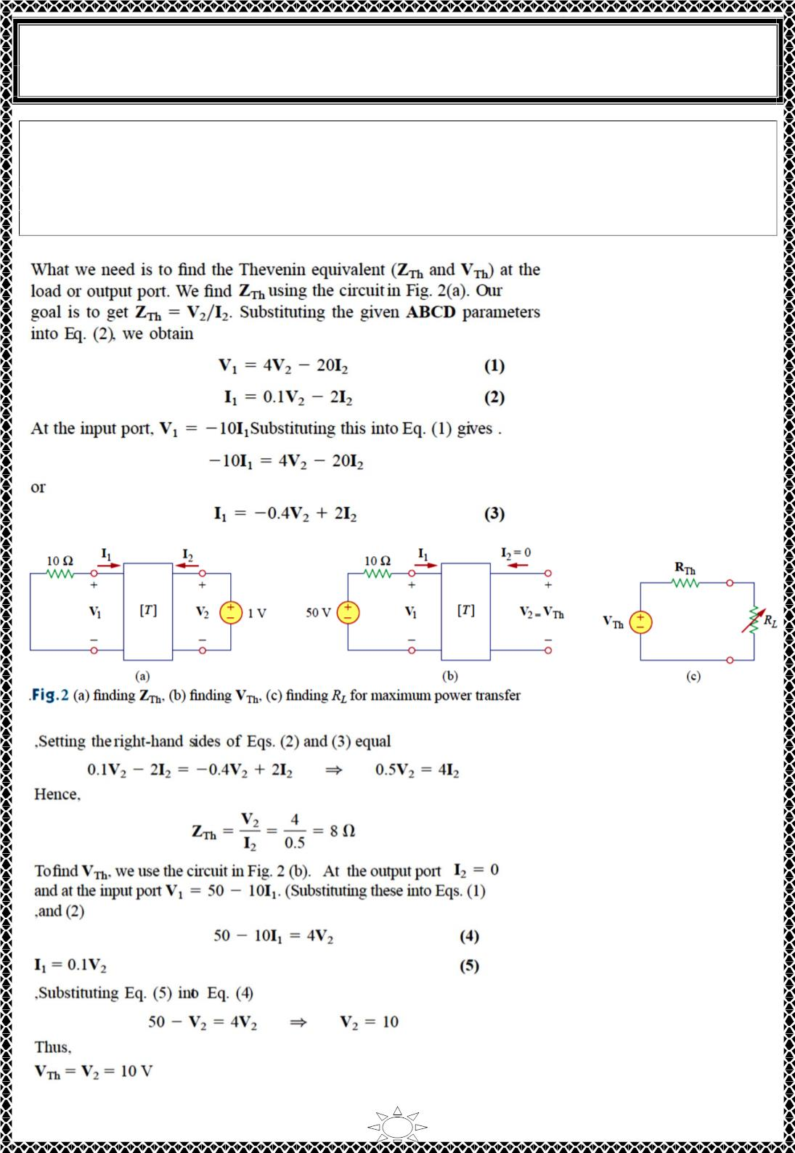
University of Diyala
Engineering College
Electronic Department
Electrical Circuits
2nd Class
Lecturer : Wisam N. AL-Obaidi
Year (2015-2016)
Example 9: The ABCD parameters of the two-port network in Fig. 1 are
4
0.1푆
20Ω
2
[
]
The output port is connected to a variable load for maximum power transfer. Find R and
the maximum power transferred.
Solution:
L
Trail Version
Trail Version
Trail Version
Trail Version
Trail Version
Trail Version
Trail Version
Trail Version
Trail Version
Trail Version
Trail Version
Trail Version
Trail Version
20

Slide 8
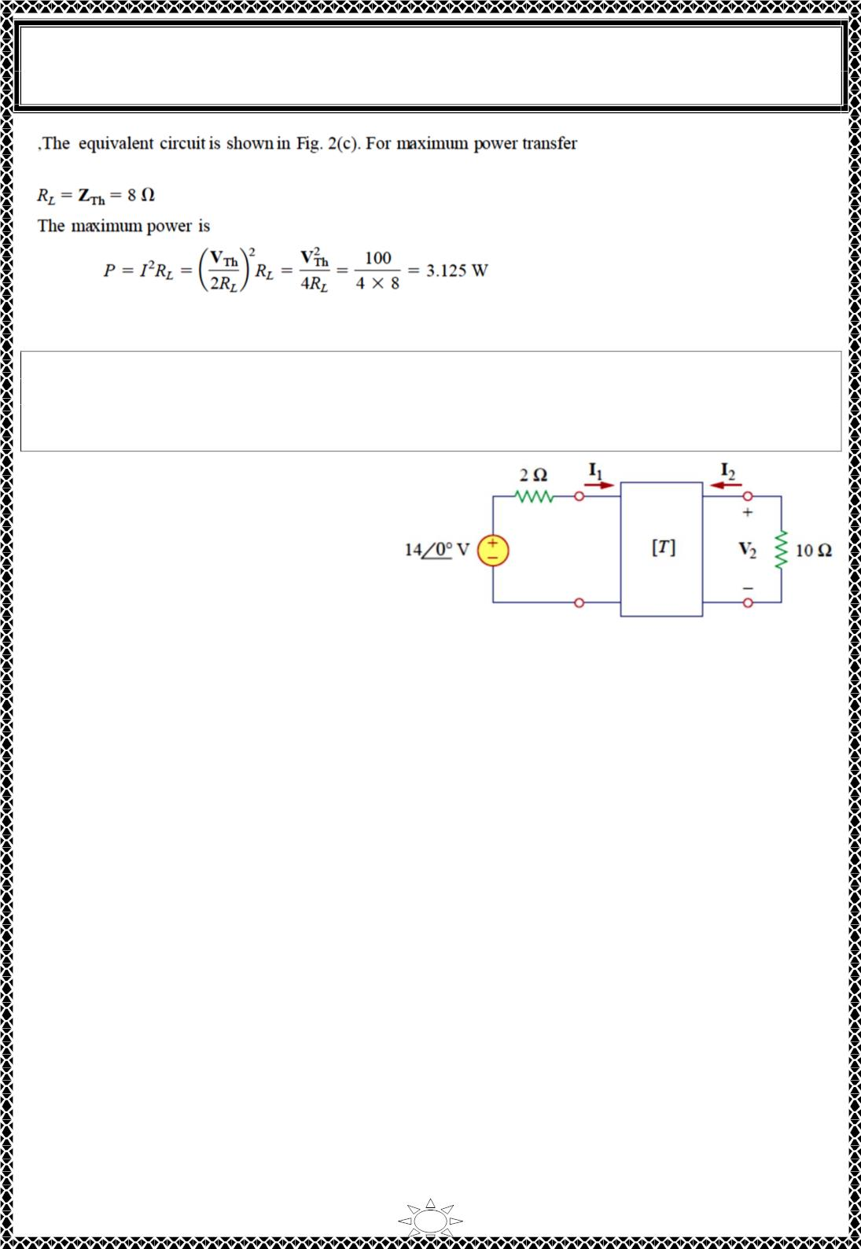
University of Diyala
Engineering College
Electronic Department
Electrical Circuits
2nd Class
Lecturer : Wisam N. AL-Obaidi
Year (2015-2016)
H.W.9: Find I and I if the transmission parameters for the two-port in Fig.
1
2
5
0.4푆
10Ω
1
[
]
Answer:
1 A, - 0.2 A.
Trail Version
Trail Version
Trail Version
Trail Version
Trail Version
Trail Version
Trail Version
Trail Version
Trail Version
Trail Version
Trail Version
Trail Version
Trail Version
21

Slide 9
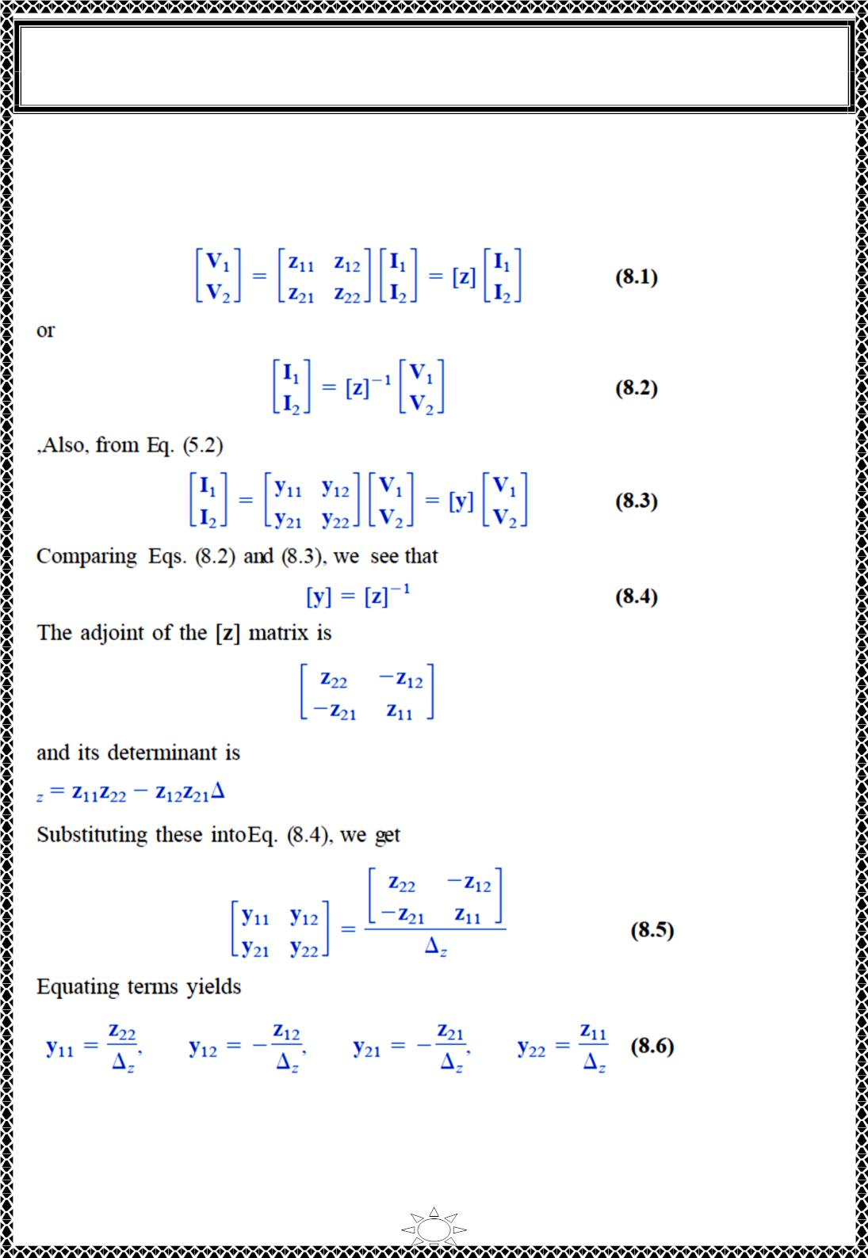
University of Diyala
Engineering College
Electronic Department
Electrical Circuits
2nd Class
Lecturer : Wisam N. AL-Obaidi
Year (2015-2016)
7)Relationships Between Parameters
Since the six sets of parameters relate the same input and output terminal variables of the
same two-port network, they should be interrelated.
Trail Version
Trail Version
Trail Version
Trail Version
Trail Version
Trail Version
Trail Version
Trail Version
Trail Version
Trail Version
Trail Version
Trail Version
Trail Version
22

Slide 10
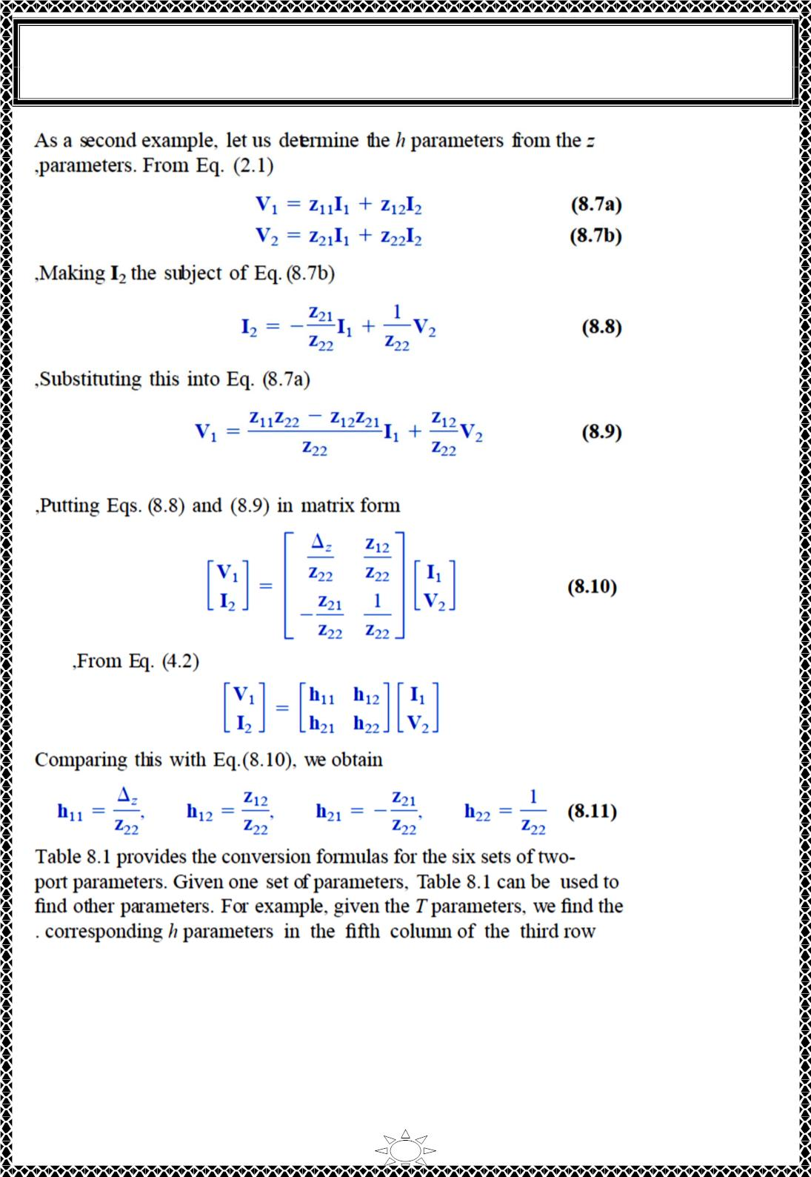
University of Diyala
Engineering College
Electronic Department
Electrical Circuits
2nd Class
Lecturer : Wisam N. AL-Obaidi
Year (2015-2016)
Trail Version
Trail Version
Trail Version
Trail Version
Trail Version
Trail Version
Trail Version
Trail Version
Trail Version
Trail Version
Trail Version
Trail Version
Trail Version
23

